Slide 1

Rationale
Introduction to Windows Store App Development Using HTML5 and JavaScript
Computer science is a field of study that deals with solving a variety of problems by using computers.
  To solve a given problem by using computers, you need to design an algorithm for it.
Multiple algorithms can be designed to solve a particular problem.
An algorithm that provides the maximum efficiency should be used for solving the problem.
  The efficiency of an algorithm can be improved by using an appropriate data structure.
Data structures help in creating programs that are simple, reusable, and easy to maintain.
This module will enable a learner to select and implement an appropriate data structure and algorithm to solve a given programming problem.

Slide 2
Objectives
  In this session, you will learn to:
  Use additional UI elements
Notes:
2

Slide 3
Demo: Using Additional UI Elements and Custom Controls
  Problem Statement:
  Peter is an App Developer at SoftTech Inc. He has developed a Card Decorator app that allows users to design greeting cards. The developer has created the UI of the app and implemented the functionality of designing the card by adding and positioning images.
Notes:
3

Slide 4
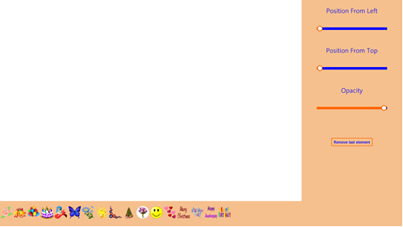
Demo: Using Additional UI Elements and Custom Controls (Contd.)
  The buttons for adding the images to a greeting card are initially shown at the bottom of the app UI, as displayed in the following figure.
Notes:
4

Slide 5
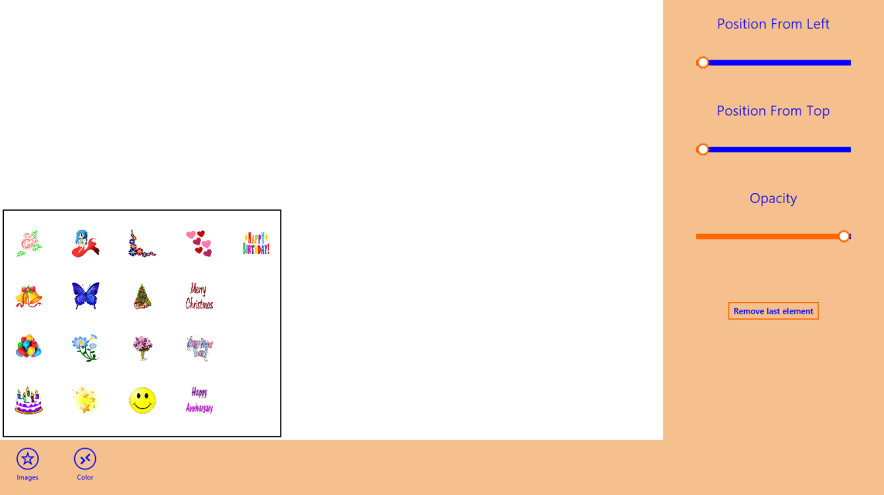
Demo: Using Additional UI Elements and Custom Controls (Contd.)
  Now, Peter wants to display the buttons to add images in a menu, as shown in the following figure.
Notes:
5

Slide 6
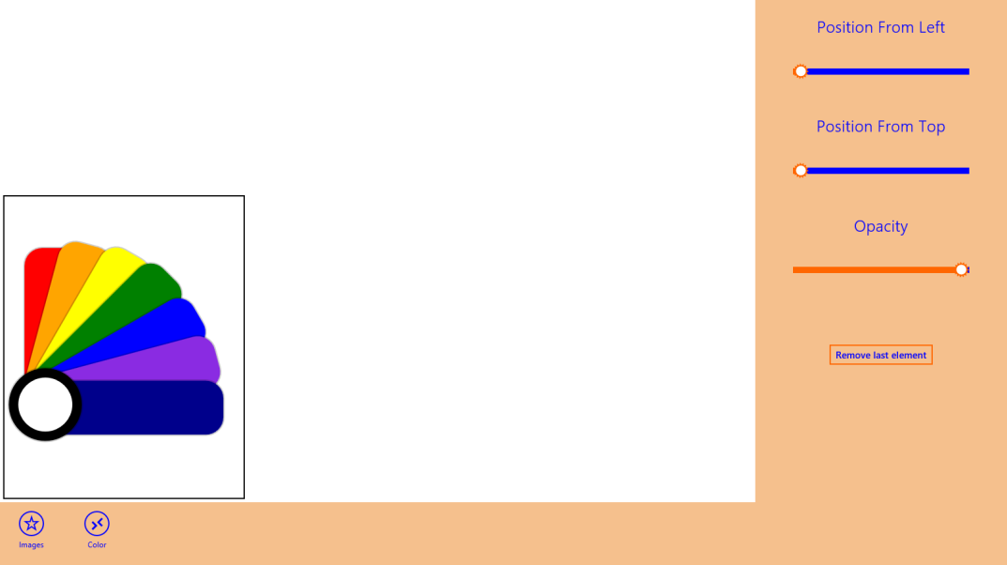
Demo: Using Additional UI Elements and Custom Controls (Contd.)
  In addition, Peter wants to create a color picker control for changing the background color of a greeting card, as shown in the following figure.
  Help Peter to add the preceding functionalities to the app.
Notes:
6

Slide 7
Demo: Using Additional UI Elements and Custom Controls (Contd.)
  Solution:
  To implement the required functionality in the app, Peter needs to perform the following tasks:
    1. Modify the buttons in the app UI.
    2. Add styles to the buttons.
    3. Add the images menu in the app UI.
    4. Define the color picker control.
    5. Add the color picker control to the app UI.
    6. Add functionality to the buttons.
    7. Handle the event of the color picker control.
    8. Execute the app and verify the output.
Notes:
7

Slide 8
Summary
  In this session, you learned that:
  A Menu control is a WinJS control that is used to display a menu of options.
  A custom control is the same as any predefined control.
  Similar to a predefined control, a custom control will also have its properties, methods, and events.
Notes:
8

Slide 9


What’s Next?
  You need to perform the following exercises of IWSADHJ Chapter 5 in the MR session:
  Exercise 3
  Exercise 4
  In addition, you need to perform the following exercises of IWSADHJ Chapter 6:
  Exercise 1
  Exercise 2

Slide 10

Q&A

